Slide 1

Energy Consumption
Merna Medhat

Slide 2
Steps Project
Using libraries
Connection Data
Read File
Explore Data
Clean
Outlier
Analysis
Statistics

Slide 3
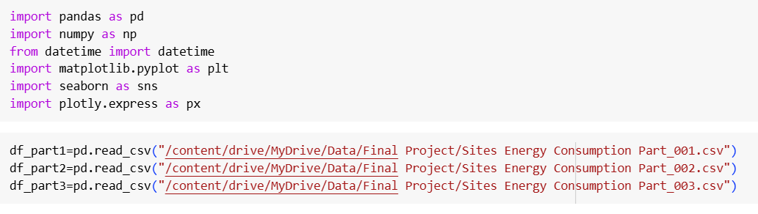
Use libraries—Connect Data

Slide 4
Problem Clean
Cell_id problem missing value example:
MAC000016: 721 rows
MAC000069: 6337 rows
MAC000050: 5092 rows
MAC000080: 7108 rows
Solve using drop cell_id index

Slide 5
Concatenate Data frames
Concatenate 3 files
Drop index
Shape data(1349802, 5)
Add new column Time and Date from Column DateTime using split

Slide 6
Change Type
Time to datetime extract Hour
Date to datetime extract Day, Month, Year
DateTime to datetime to merge file Demand
Day –Hour- Month – Year change type string

Slide 7
Duplicated
Find duplicated data: 942 rows
Drop duplicated
New columns Day of Week and Day Type
New column AM-PM

Slide 8
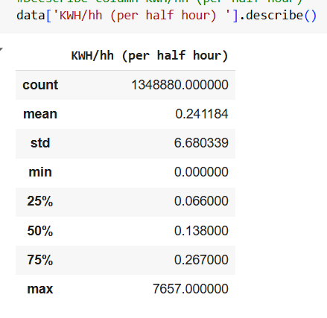
Describe
Note:
mean < std so then find outlier
50% = 0.136000
max = 7657,
so then find the outlier.

Slide 9
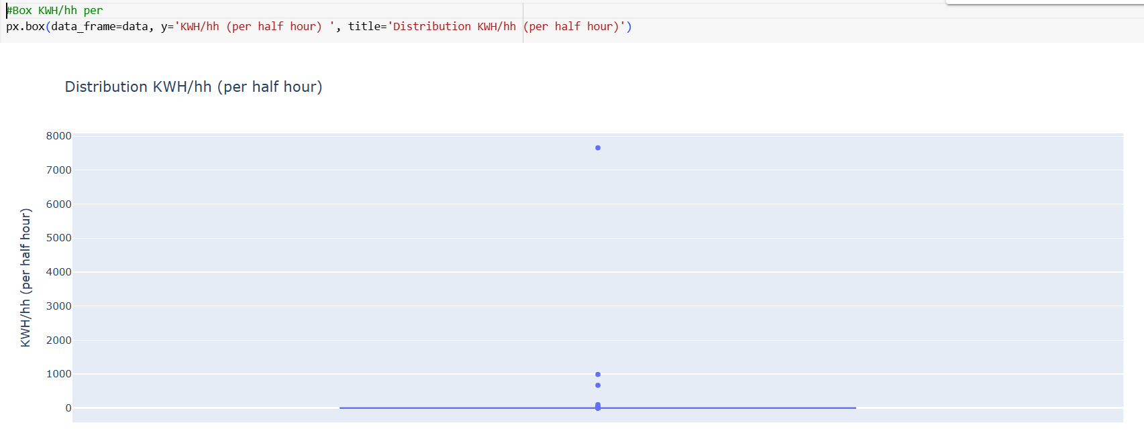
Boxplot KWH/hh

Slide 10
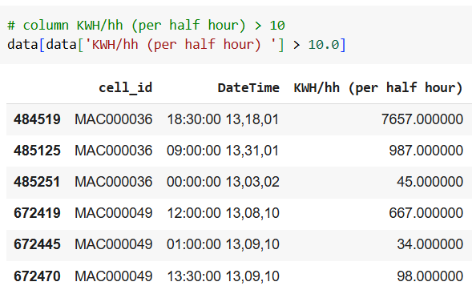
Explore Outlier
note
mean = 0.242335
median = 0.136000
no normal value and fewer rows
so that use drops rows

Slide 11
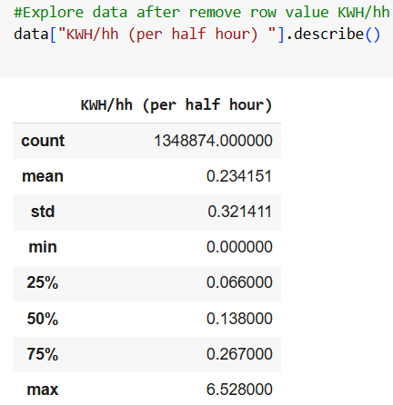
Describe after remove rows
note:
mean =0.232536
std = 0.320819 so that outlier but
median = 0.136000
Still find outlier data

Slide 12
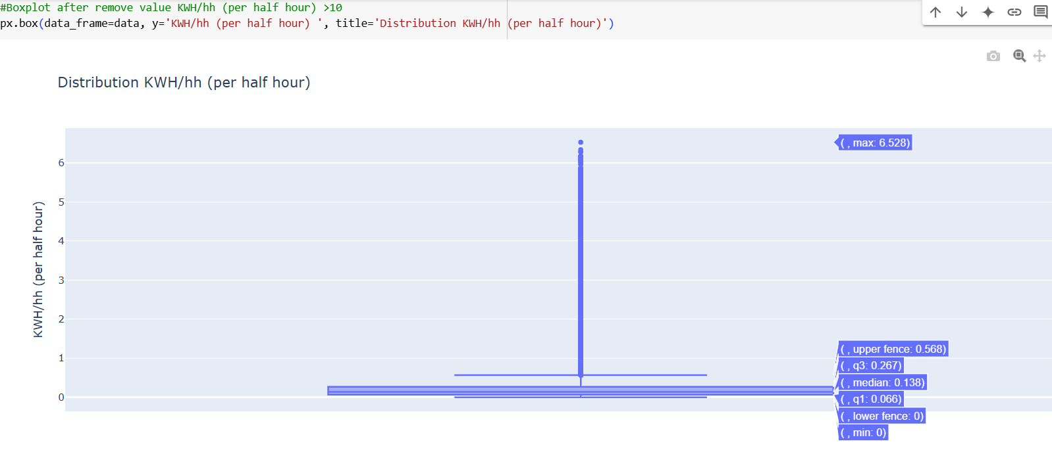
Boxplot KWH/hh

Slide 13
IQR KWH/hh
Range value normal lower limit = -0.2355 and upper limit = 0.5685
No find negative value KWH/hh
Values > upper limit no edit values still keep values KWH/hh
range [0.5685: 6.528]
Outlier: 117242 rows
Normal values: 1231632 rows

Slide 14
Explore IQR
All data range [0.0 : 6.528]
KWH/hh(per half hour) value=0: 46604 rows
Compare two column IQR KWH/hh =1 and KWH/hh >= 0.00 and KWH/hh < 0.55 : 0 rows
Compare two column IQR KWH/hh =1 and KWH/hh > 0.57 and KWH/hh < 1: 75131 rows
Compare two column IQR KWH/hh =1 and KWH/hh >= 1: 42111 rows

Slide 15
Outlier MAD
Normal values: 992580 rows
No normal values: 356294 rows
Compare two column MAD KWH/hh 1 and KWH/hh >= 0.0 and KWH/hh < 0.25 : (0 row)
Compare two column MAD KWH/hh 1 and KWH/hh >= 0.25 and KWH/hh < 1: (314183 rows)
Compare two column MAD KWH/hh= 1 and KWH/hh >= 1: (42111 rows)

Slide 16
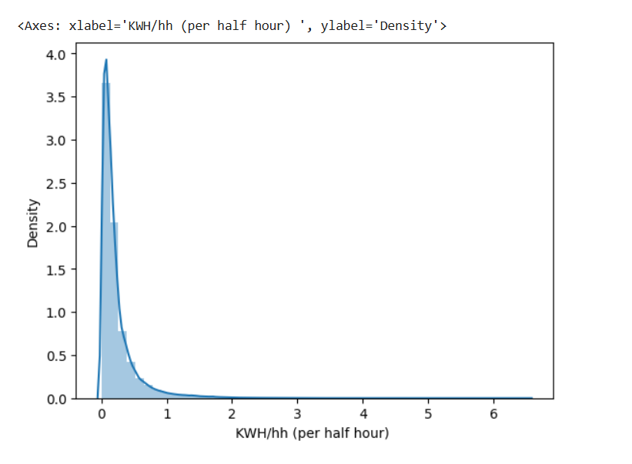
Seaborn Distplot KWH/hh
Data: right-skewed
mean =0.232536
median = 0.136000
Mean > Median > Mode

Slide 17
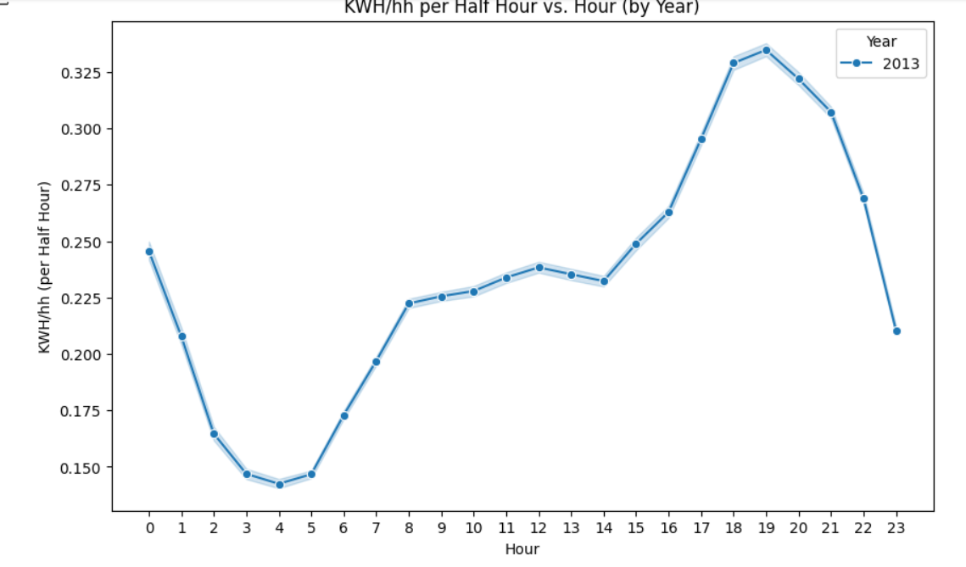
Line plot for KWH/hh over time by Hour
Number hour different
The most value KWH/hh range [18:21] PM
After hour 14 PM start increase KWH/hh
Less KWH/hh hour range [3:5] AM
Average KWH/hh hour range [8:14] AM To PM

Slide 18
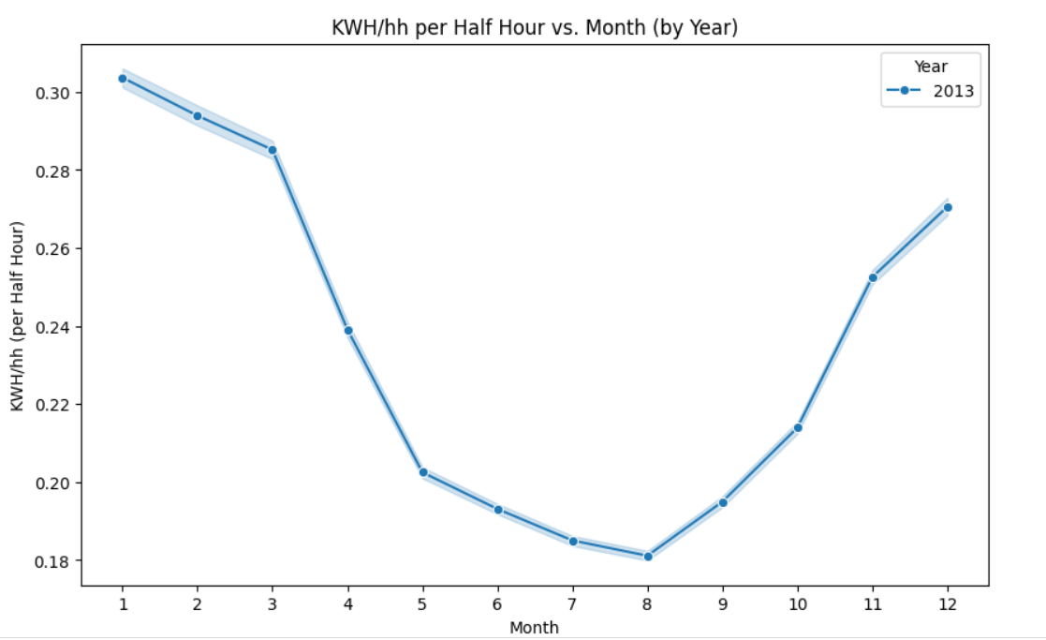
Line plot for KWH/hh over time (by Month)
The most month (1-2-3-11-12 )
Average month ( 4-5-10 )
Less month (8-7)

Slide 19
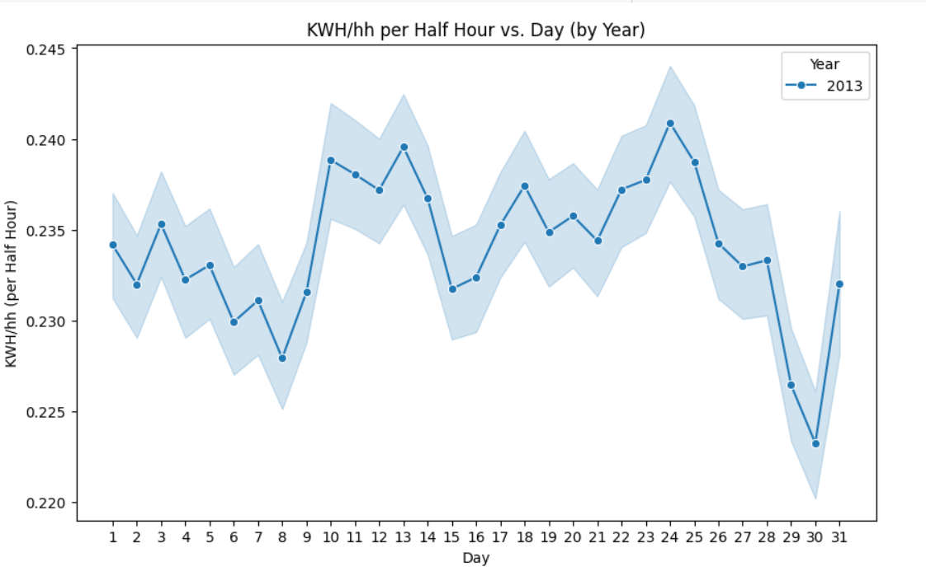
Line plot for KWH/hh over time (by Day)
Distribution Days KWH/hh

Slide 20
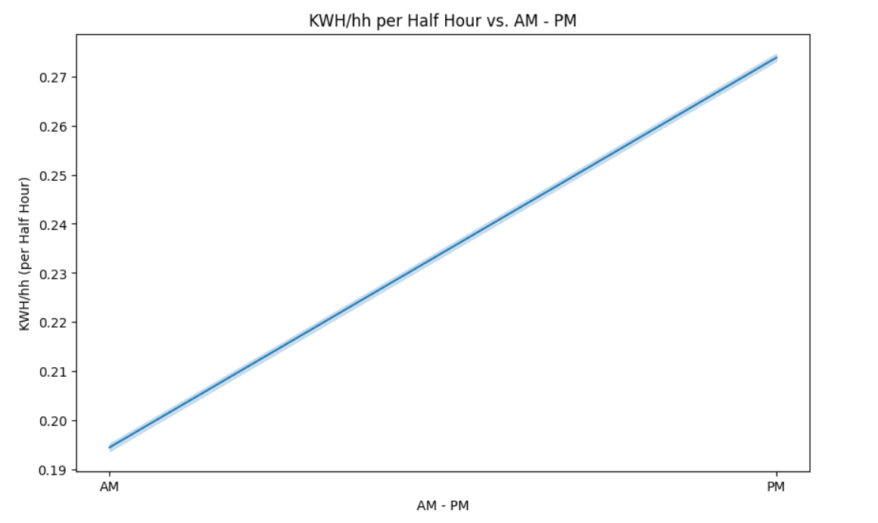
Line plot for KWH/hh over time (by AM -PM)
Different values compare AM –PM
PM values KWH/hh > AM

Slide 21
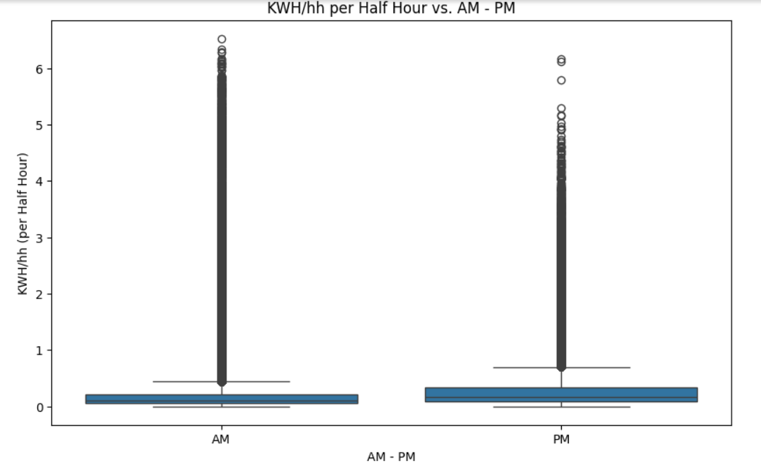
Boxplot for KWH/hh vs. AM_PM
Values outlier AM more than PM

Slide 22
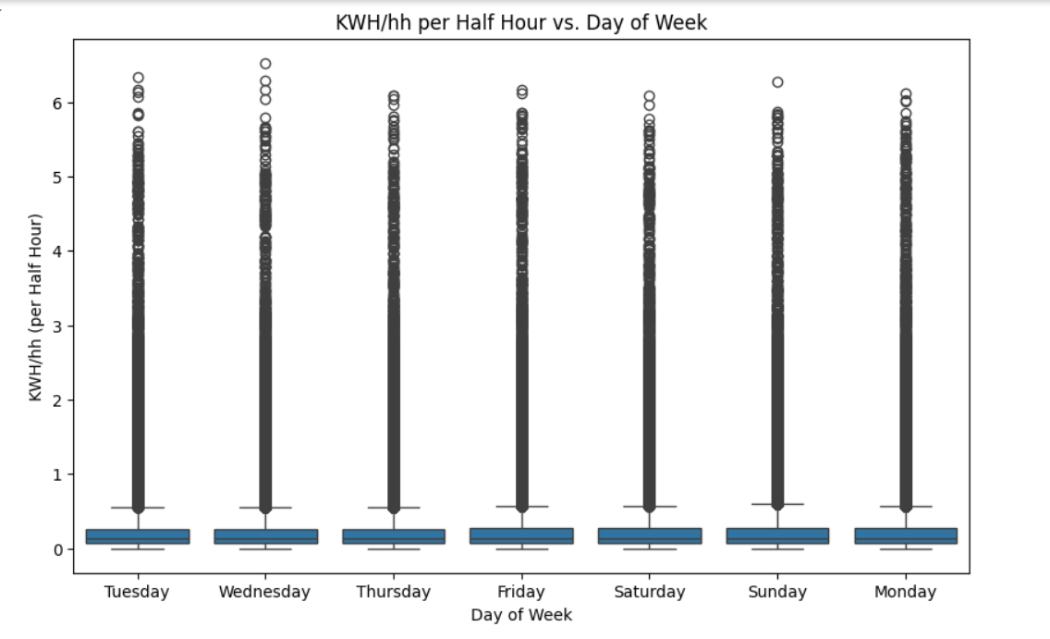
Boxplot for KWH/hh vs. Day of Week
Distribution values outlier Day of week

Slide 23
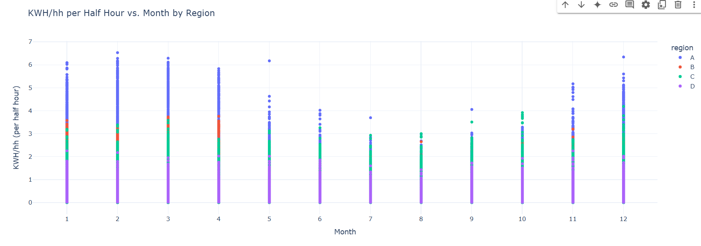
px.scatter KWH/hh per Half Hour vs. Month by Region
The most values region A
Minimum values region D
Region C –B close value

Slide 24
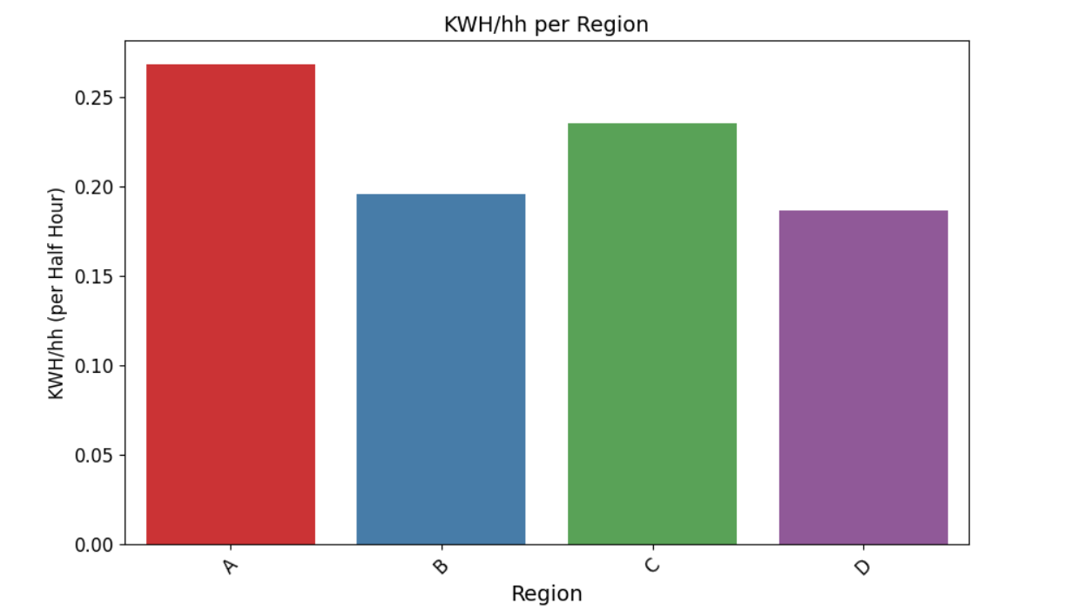
Bar plot between KWH/hh per Region
Region A> C>B>D

Slide 25
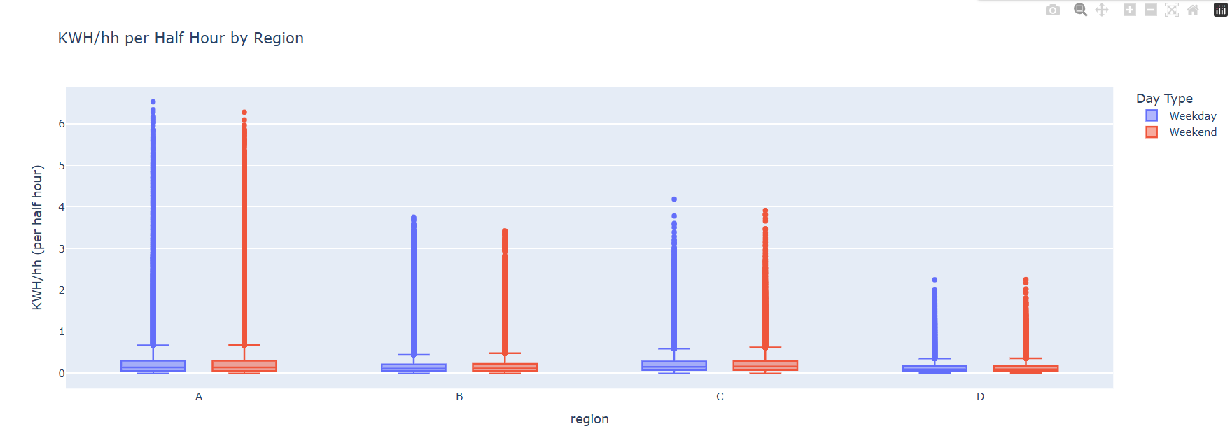
Box plot KWH/hh per region during day type
Distribution values outlier for region
A>C>B>D
Weekday > Weekend in all region

Slide 26
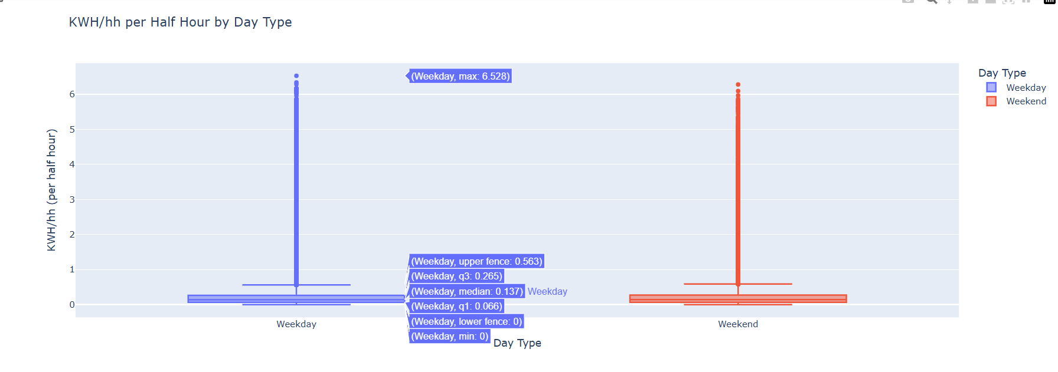
Box Plot KWH/hh per Day Type
Compare Weekday and Weekend in outlier values

Slide 27
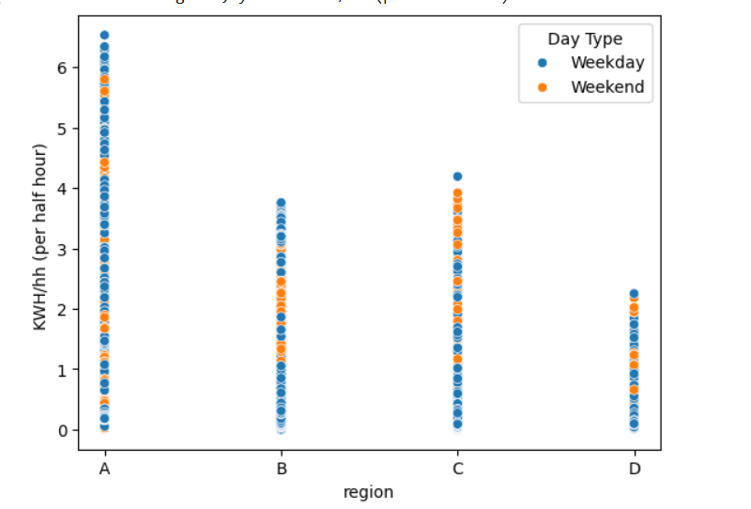
Scatterplot KWH/hh per Region
Weekend the most in region C
Minimum region D

Slide 28
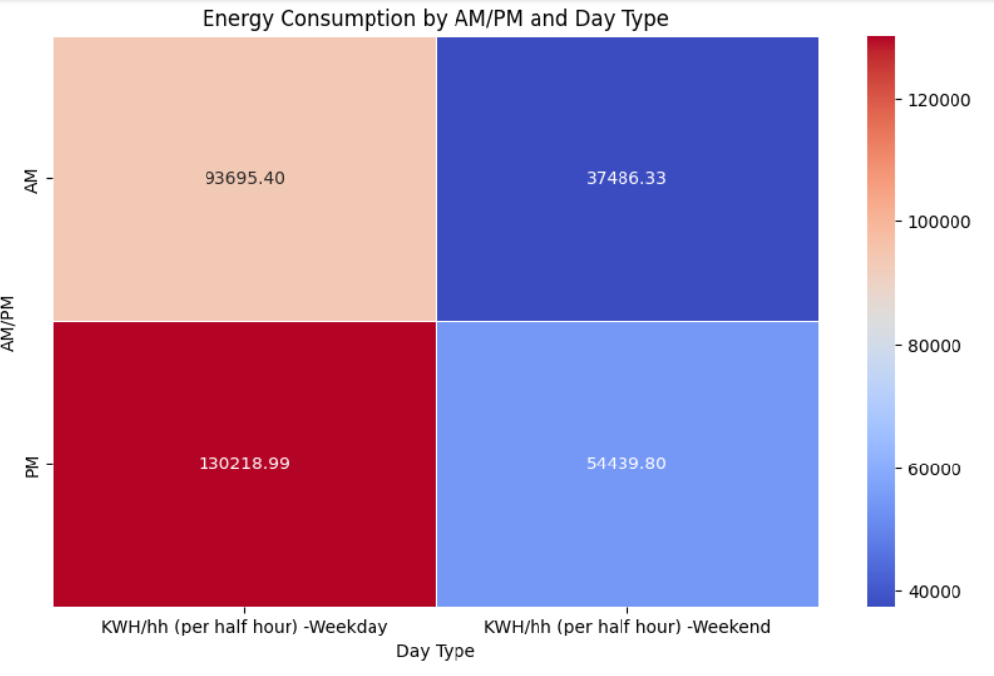
Compare KWH/hh (per half hour) between((AM or PM) and Day Type)
The greatest amount of PM is consumed during the weekend and weekday.
PM hours are longer than AM.

Slide 29
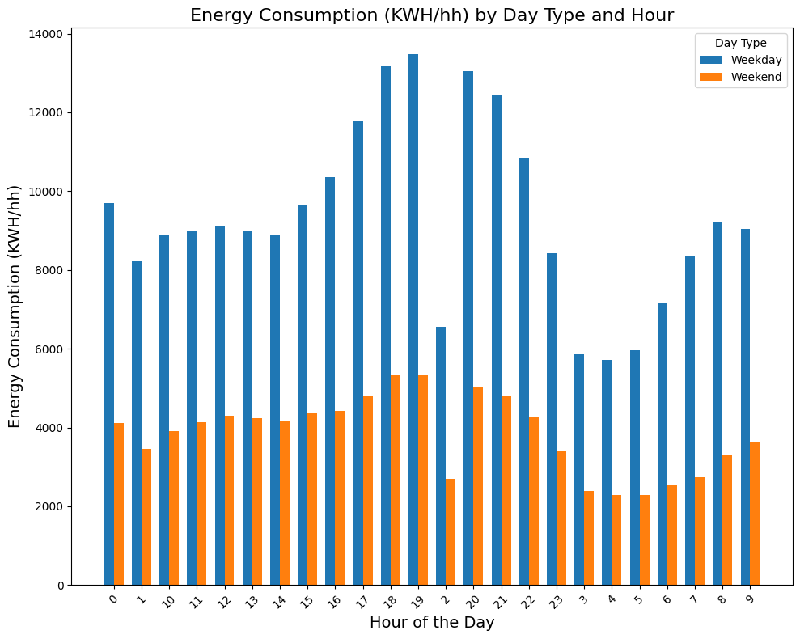
Compare KWH/hh (per half hour) between(Hour and Day Type)
Energy consumption during weekdays (blue bars) higher than weekend (orange bars) all hours of the day
Top hour(17 ,18 ,19,20,21,22) PM

Slide 30
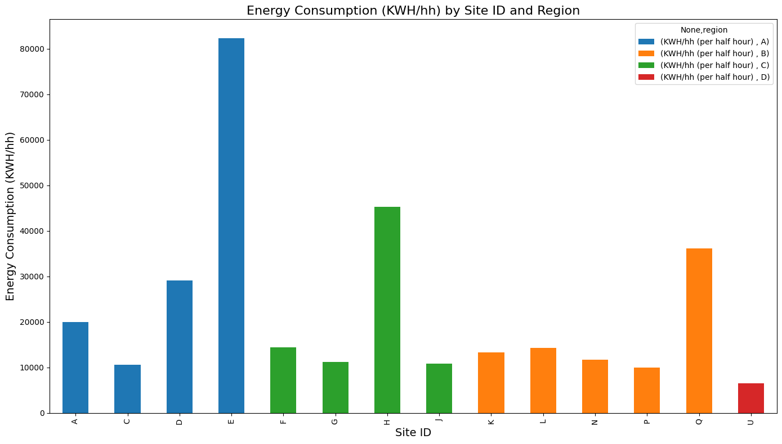
Electricity Usage By Site_id and Region
Region A for site_id (E >D>A>C)
Region C for site_id (H>F>G>J)
Region B for site_id (Q >L>K>N>P)
Region D for site_id (U)

Slide 31
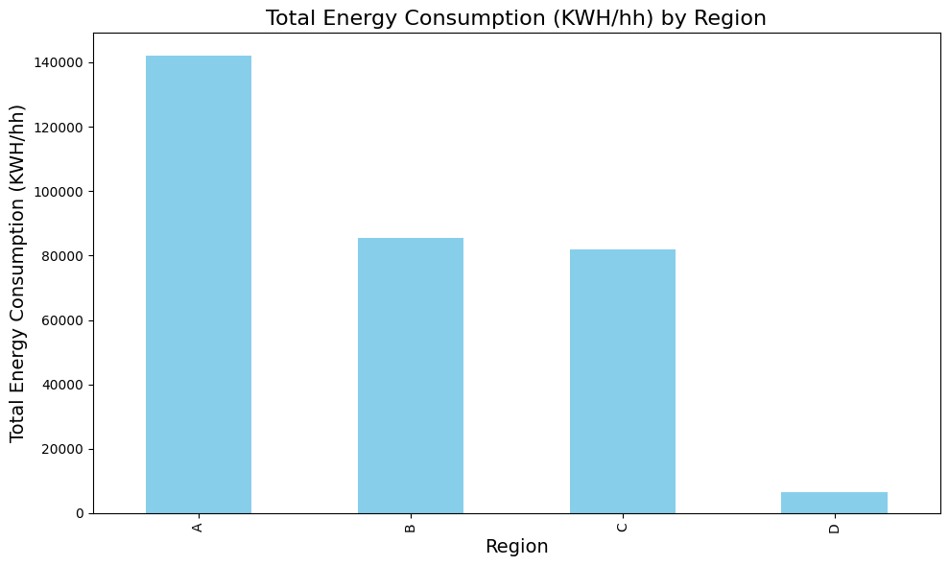
Region of Electricity Consumption.
Region : A>B>C>D

Slide 32
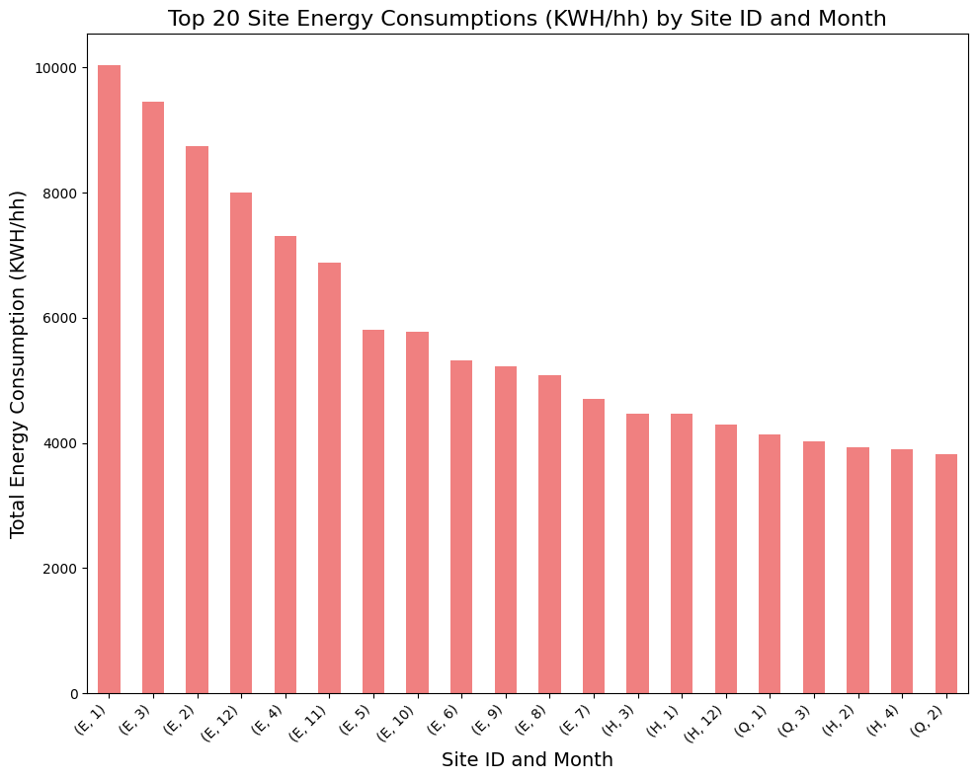
Top20 (Site_id Electricity Consumption By Month)
Region A site_id E during month range[1 : 12] that 11 month not find in most values
Region C for site_id (H) during month 3>1>12>4
Region B for site_id (Q )during month 1>3>2
Top months in site_id months 1-2-3

Slide 33
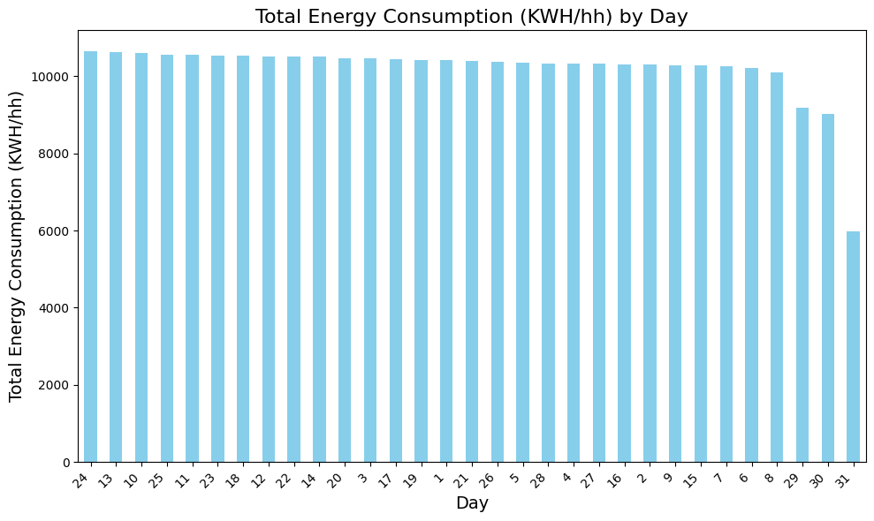
Day Consumption
Distribution Days KWH/hh
Less values days 29-30-31

Slide 34
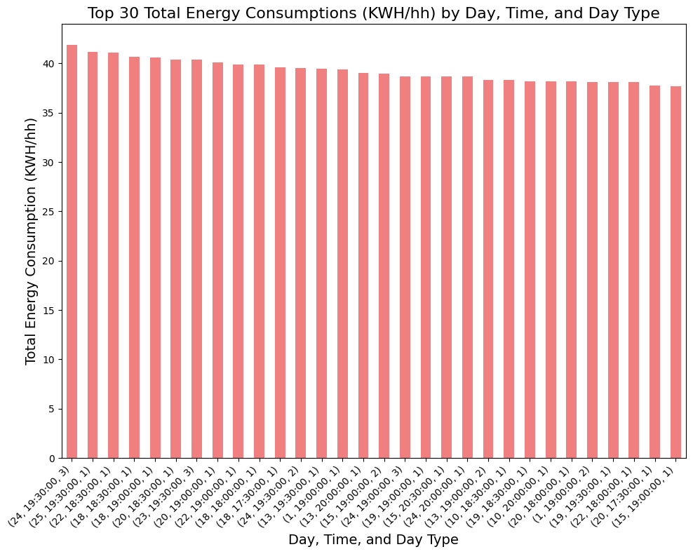
Top 20 Day Consumption By ( Time and Day Type)
Months mode( 1-2-3)
Days mode (24-25-22-18-20-23-19)
Time hour mode (18 -19-20)PM

Slide 35
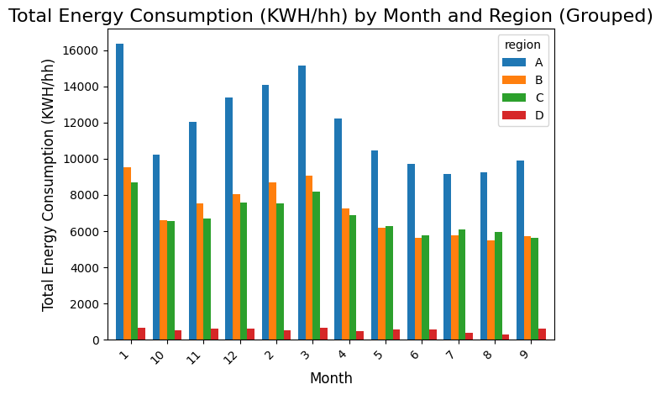
Electricity During By Months and Region
Month 10
Region A> (B~=C)>D
Month 11-12-2-3-4-1
Region A>B>C>D
Month 5 -6-7-9
Region A>C>B>D

Slide 36
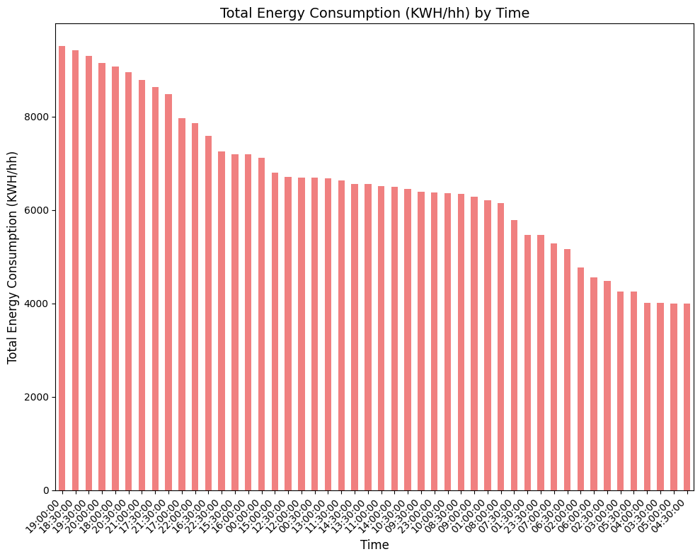
Time Consumption
Highest consumption: Evening period (18:00 - 23:00),
Moderate consumption: Afternoon period (12:00 - 17:59),
Lowest consumption: Morning period (06:00 - 11:59)

Slide 37
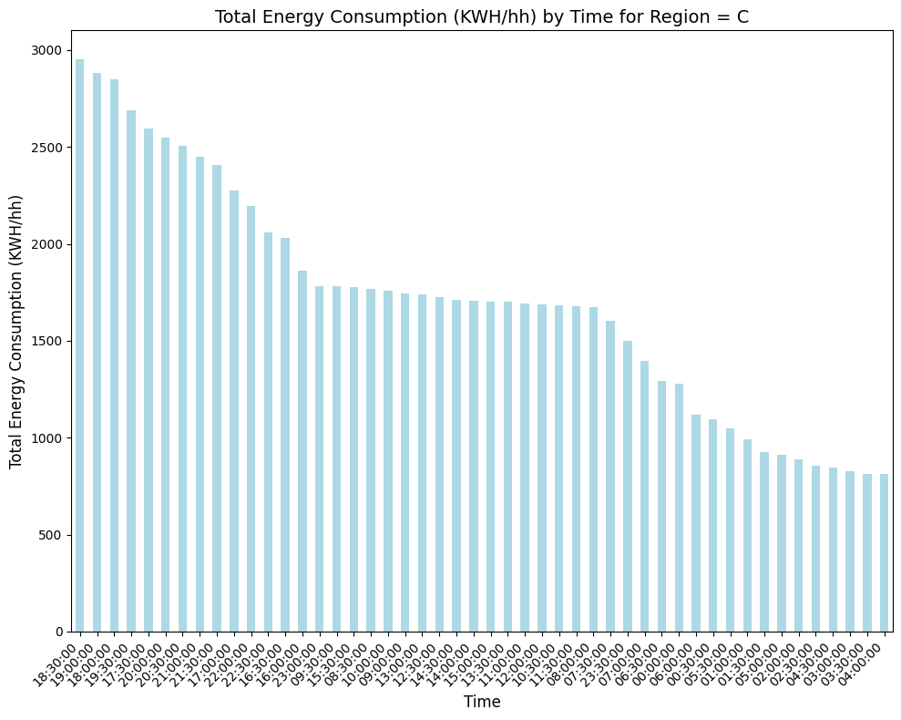
Total Energy Consumption (KWH/hh) by Time for Region
Highest consumption: Evening period (16:00 - 23:00),
Moderate consumption: Afternoon period (12:00 - 15:59),
Lowest consumption: Morning period (01:00 - 5:00)
Apply Time in all Region

Slide 38
File Demand
Connect Data
Check Duplicated appear 0 duplicated
Replace string Normall and high to Normal and High
Merge two data on DateTime
New column price use np.where
Column price / 100 to EGP
New column cost = price * KWH/hh
Add condition KWH/hh < 0.1 choice value 0.1 less median site_id
New column new KWH/hh add value after use condition
New column Save = price * new KWH/hh

Slide 39
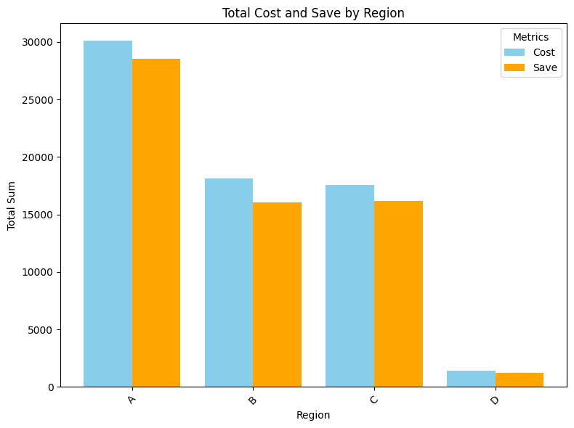
Compare Region between Cost and Save
Save money region
The most value A
Minimum D
C and B close value

Slide 40
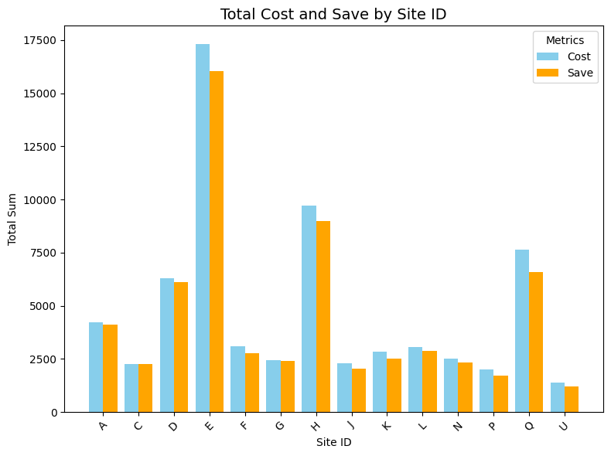
Compare Site between Cost and Save
Save Money
The most site_id E-H-Q
Other site_id simply different between cost and save

Slide 41
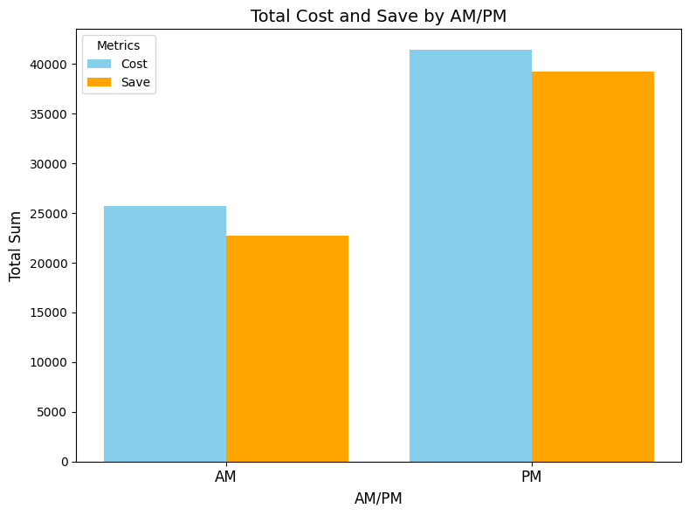
Compare AM-PM between Cost and Save
Save money AM >PM

Slide 42
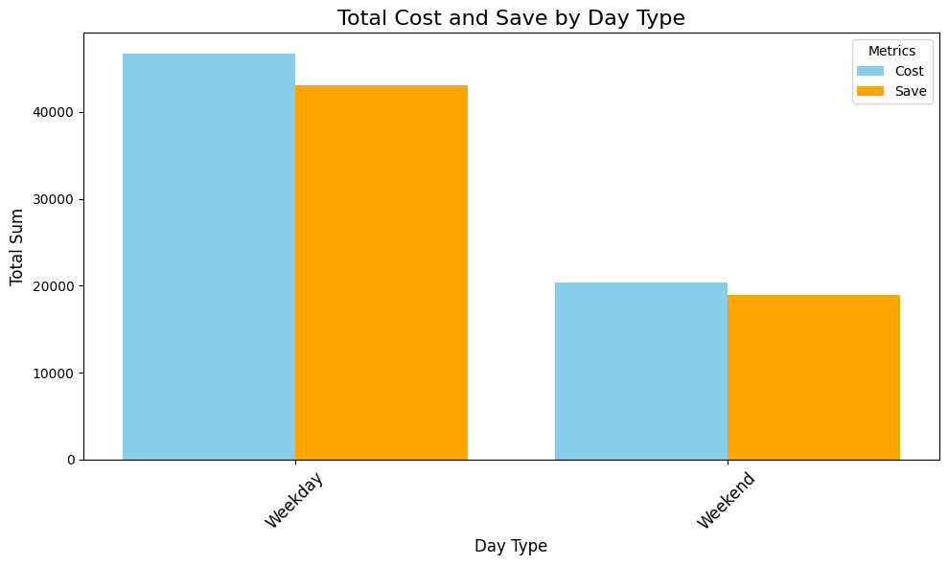
Compare Day Type between Cost and Save
Save money Weekday >Weekend

Slide 43
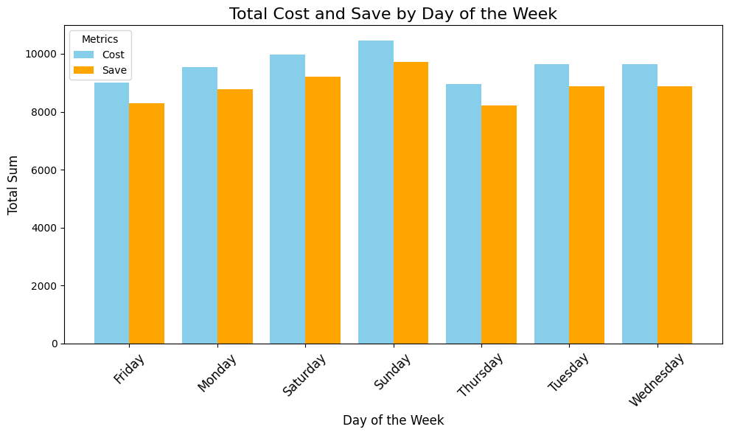
Compare Day of Week between Cost and Save
Most same effect simply different
among days

Slide 44
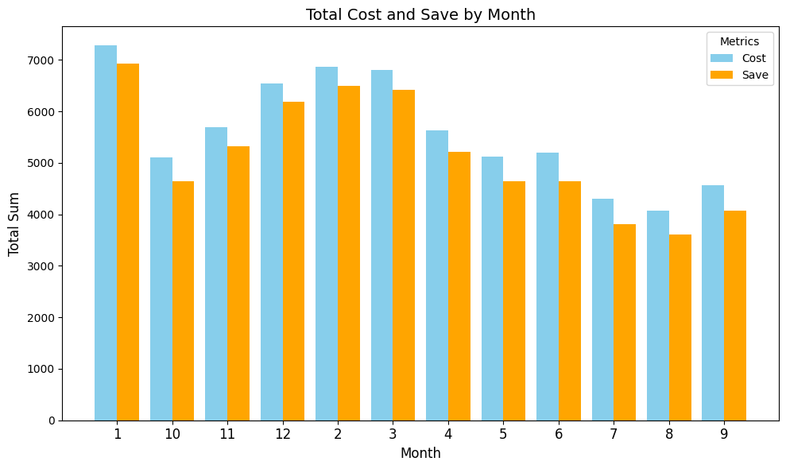
Compare Month between Cost and Save
Most same effect different
Range [300 :600] in month

Slide 45
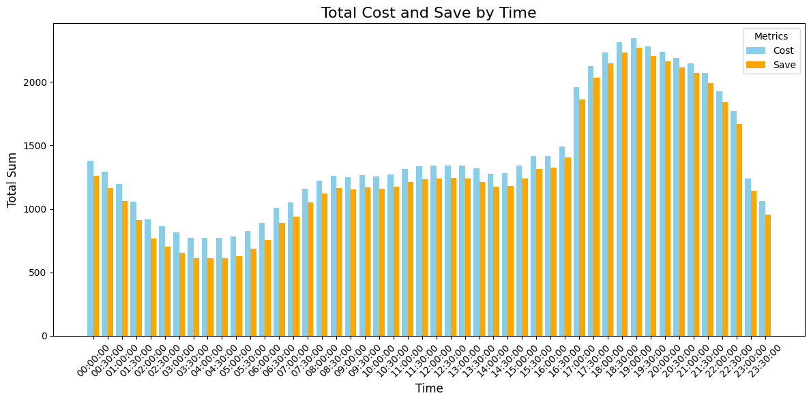
Compare Time between Cost and Save
The most effective part is less value KWH/hh during the morning period (01:00 - 5:00) AM
Less effective part is high value KWH/hh during the morning period (16:00 - 23:00) PM

Slide 46
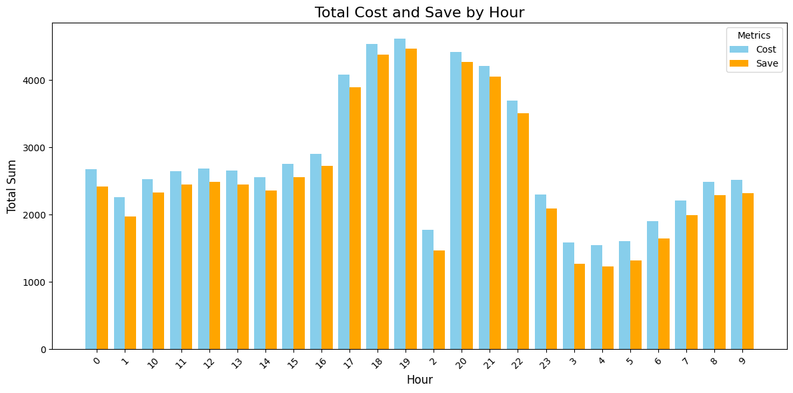
Compare Hour between Cost and Save
The most effective part is less value KWH/hh during the morning period (01:00 - 5:00) AM

Slide 47
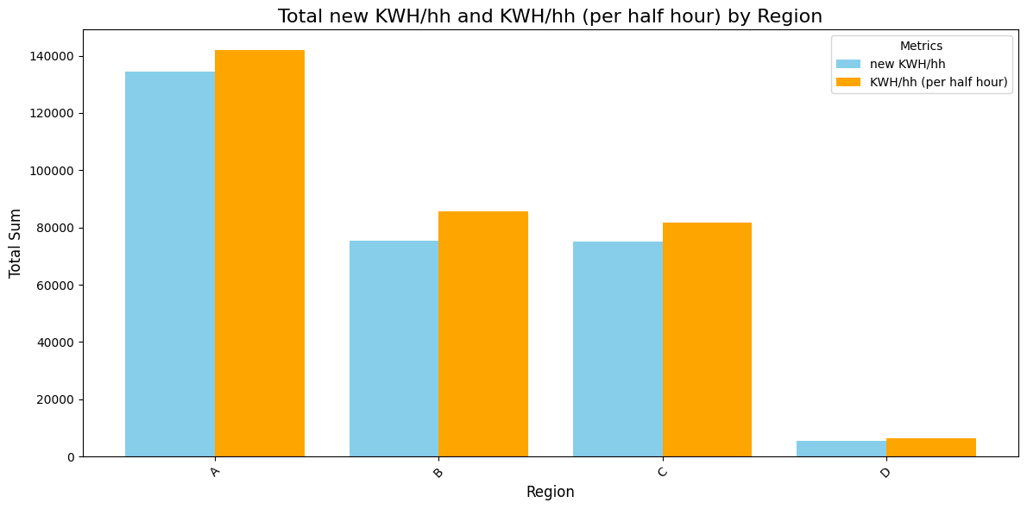
Compare Region between new KWH/hh -KWH/hh (per half hour)
Save new KWH/hh region
The most value A
Minimum D
C and B close value

Slide 48
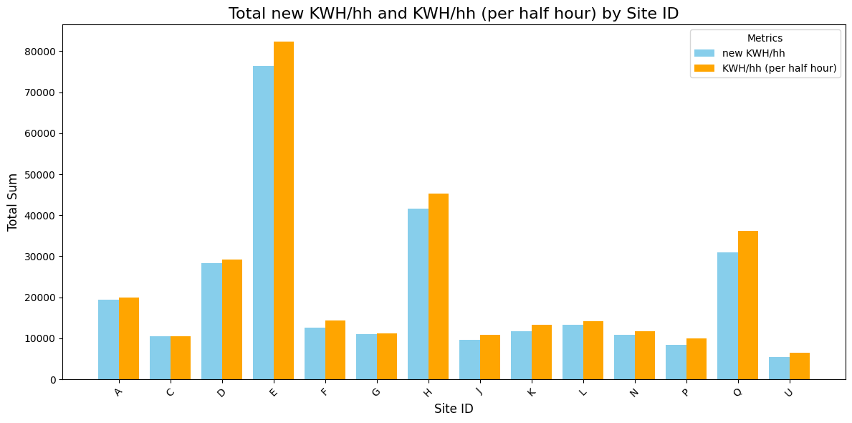
Compare Site between new KWH/hh -KWH/hh (per half hour)
Save new KWH/hh
The most site_id E-H-Q
Other site_id simply different between cost and save

Slide 49
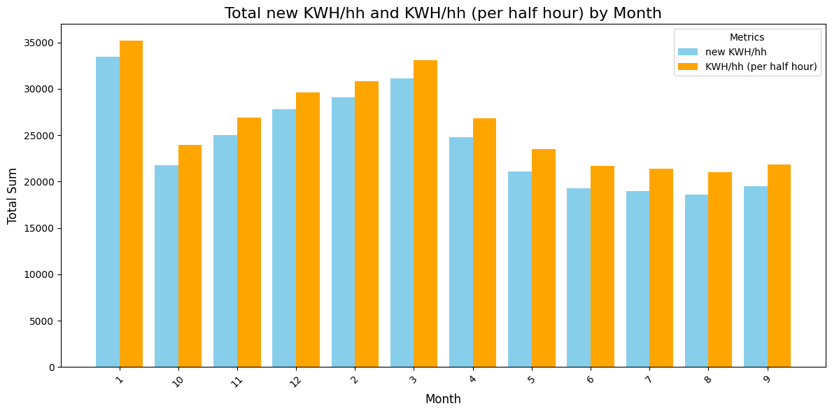
Compare Month between new KWH/hh -KWH/hh (per half hour)
Most same effect different
Range [1700 :2700] in month

Slide 50
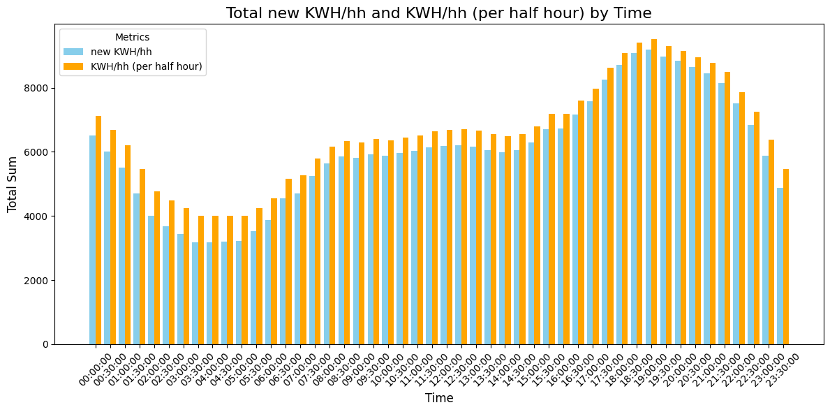
Compare Time between new KWH/hh -KWH/hh (per half hour)
The most effective part is less value KWH/hh during the morning period (01:00 - 5:00) AM
Less effective part is high value KWH/hh during the morning period (16:00 - 23:00) PM

Slide 51
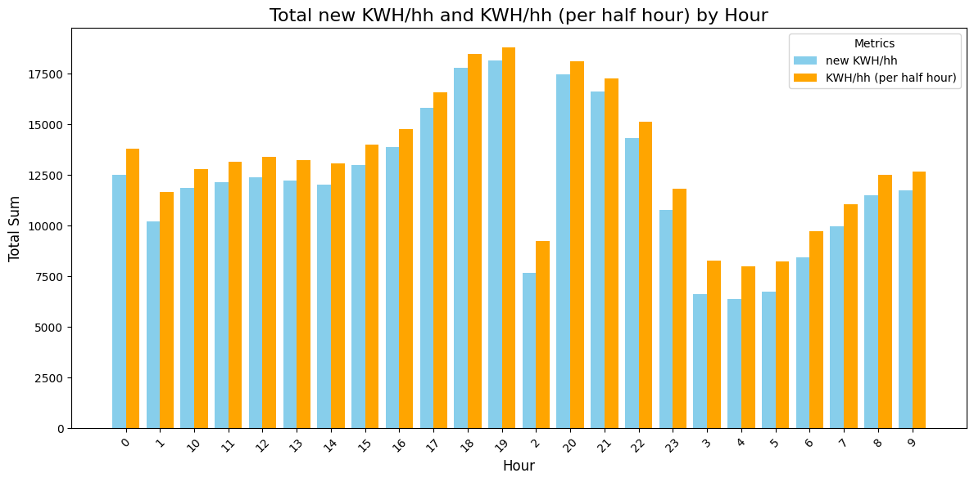
Compare Hour between new KWH/hh -KWH/hh (per half hour)
The most effective part is less value KWH/hh during the morning period (01:00 - 5:00) AM

Slide 52
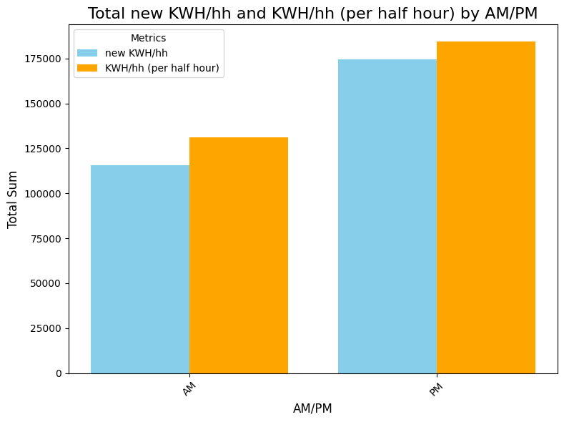
Compare AM-PM between new KWH/hh -KWH/hh (per half hour)
Save new KWH/hh AM >PM

Slide 53
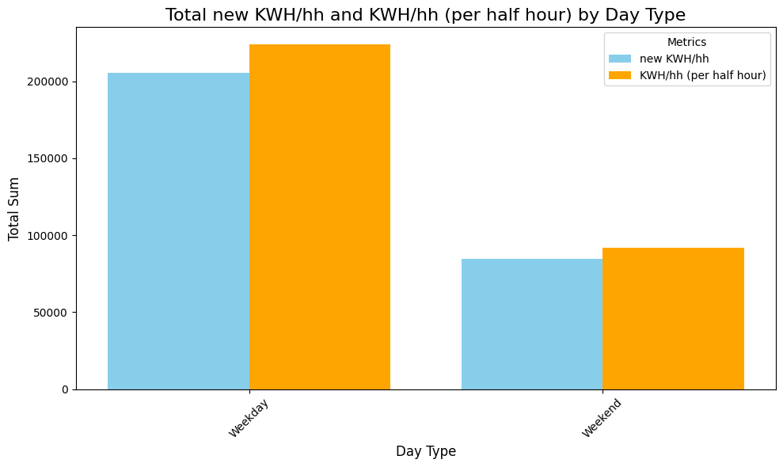
Compare Day Type between new KWH/hh -KWH/hh (per half hour)
Save new KWH/hh
Weekday >Weekend

Slide 54
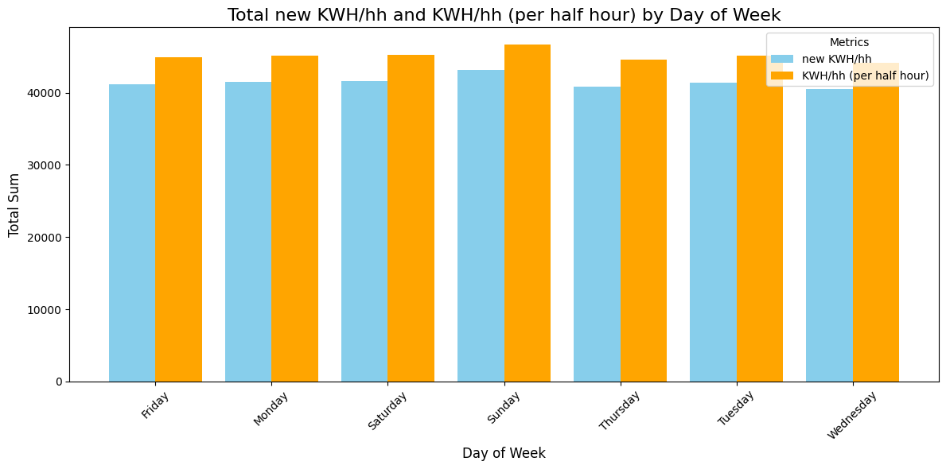
Compare Day of Week between new KWH/hh -KWH/hh (per half hour)
Most same effect simply different
among days

Slide 55
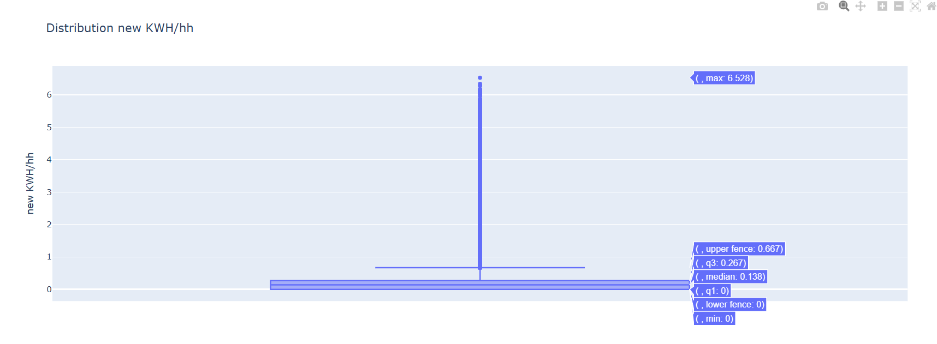
IQR new KWH/hh
lower limit = -0.4005
upper limit = 0.6675
Outlier: 89793 rows
mean =0.232536
median = 0.136000

Slide 56
Statistics
Use ANOVA

Slide 57
HO: There is no significant difference in electricity consumption between the sites. HA: There is a significant difference in electricity consumption between the sites.
P-value =0.0
Visualization
Result : We reject H0 , meaning different between the sites

Slide 58
H0: There is no significant difference in electricity consumption between the days. HA: There is a significant difference in electricity consumption between the days.
P-value =0.0
Visualization
Result: We reject H0 that different among the days

Slide 59
H0:There is no significant difference in electricity consumption between the months. HA: There is a significant difference in electricity consumption between the months
P-value=0.0
Visualization
Result: We reject H0 , meaning different between the months

Slide 60
H0: There is no significant difference in electricity consumption between regions. HA: There is a significant difference in electricity consumption between regions
P-value=0.0
Visualization
Result: We reject H0, meaning different among regions.

Slide 61
H0: There is no significant difference in electricity consumption between Hour. HA: There is a significant difference in electricity consumption between Hour
P-value
Visualization
Result: We reject H0, meaning different among Hour

Slide 62
HO: There is no significant difference in Save money between the sites. HA: There is a significant difference Save money in between the sites
P-value =0.0
Visualization
Result: We reject H0 , meaning different between the sites

Slide 63
H0: There is no significant difference in Save money between regions. HA: There is a significant difference in Save money between regions
P-value =0.0
Visualization
Result: We reject H0, meaning different among regions

Slide 64
H0:There is no significant difference in Save money between the months. HA: There is a significant difference in Save money between the months
P-value=0.0
Visualization
Result: We reject H0 ,meaning different across the months.

Slide 65
H0: There is no significant difference in Save money between Hour. HA: There is a significant difference in Save money between Hour
P-value =0.0
Visualization
Result: We reject H0, meaning different among Hour.

Slide 66
H0: There is no significant difference in Save moeny between Day of Week HA: There is a significant difference in Save moeny between Day of Week
P-value=0.0
Visualization
Result: We reject H0, meaning different among Day of Week

Slide 67
Statistics
Use T-TEST

Slide 68
H0: There is no significant difference in electricity consumption between Day of Week. HA: There is a significant difference in electricity consumption between Day of Week
P-value =2.843973132384587e-18
Visualization
Result: We reject H0 ,meaning different between day types
P-value <0.05

Slide 69
H0: There is no significant difference in electricity consumption between AM-PM. HA: There is a significant difference in electricity consumption between AM-PM
P-value=0.0
Visualization
Result: We reject H0, meaning different between AM -PM

Slide 70
H0: There is no significant difference in Save money between Day Type. HA: There is a significant difference in Save money between Day Type
P-value =2.4262743950076814e-30
Visualization
Result: We reject H0 ,meaning different between Day Type
P-value < 0.05

Slide 71
H0: There is no significant difference in Save money between AM-PM. HA: There is a significant difference in Save money between AM-PM
P-value =0.0
Visualization
Result : We reject H0, meaning different between AM -PM

Slide 72
Insight

Slide 73
Insight
The site with the highest energy consumption is E-H-Q. Increase the electricity price for other

Slide 74
Insight
Range [0.800: 6.528], increasing the electricity price may be part of the consumption. The price of electricity for companies or manufacturers is different from residential areas and commercial places.

Slide 75
Insight
Electricity prices vary by month and region.
The highest electricity consumption is in months 1, 2, 3, 12, 4, and 11.
The region with the highest electricity consumption is A.

Slide 76
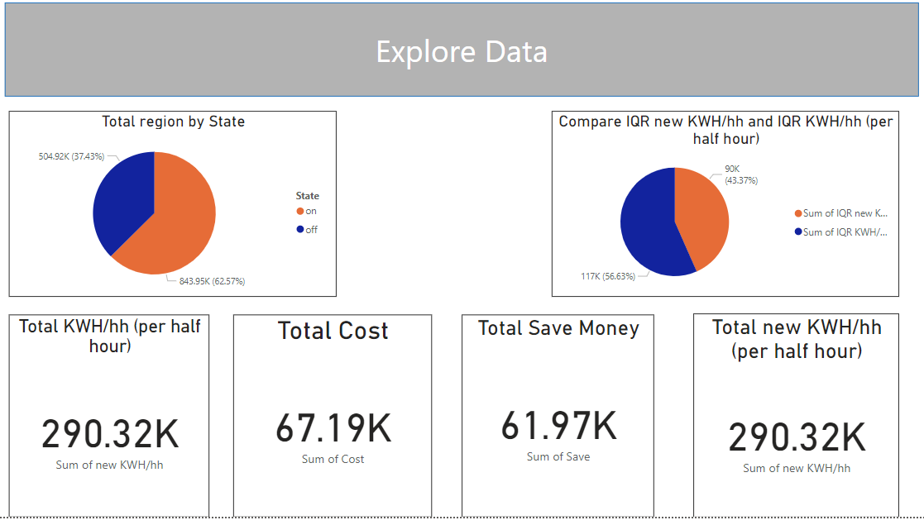
Power BI

Slide 77
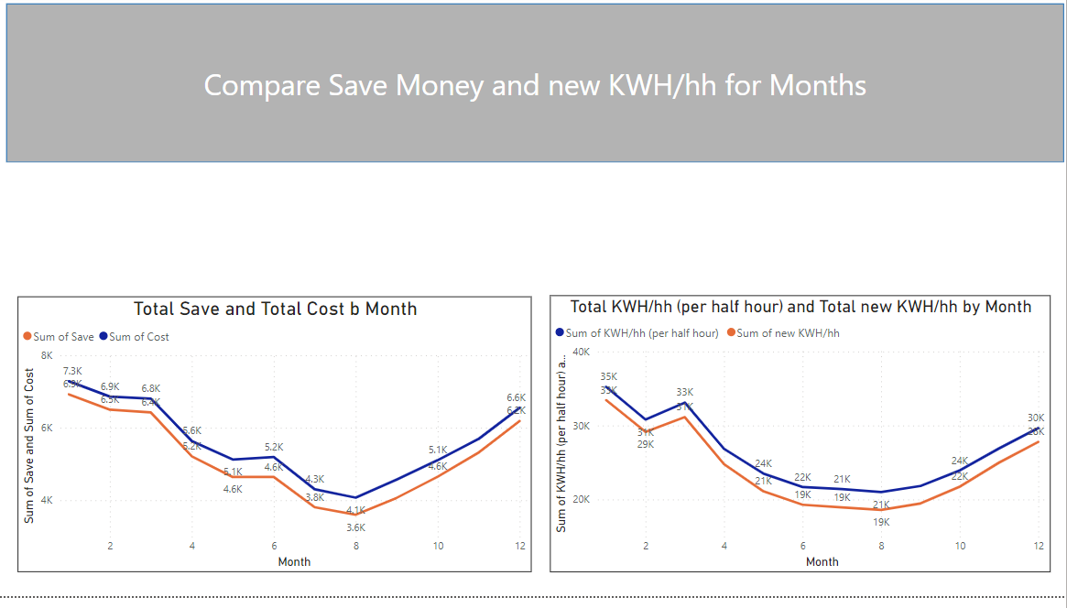
Power BI

Slide 78
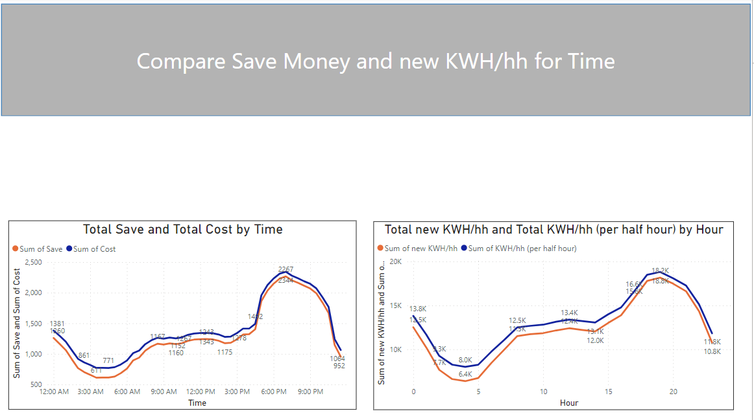
Power BI

Slide 79
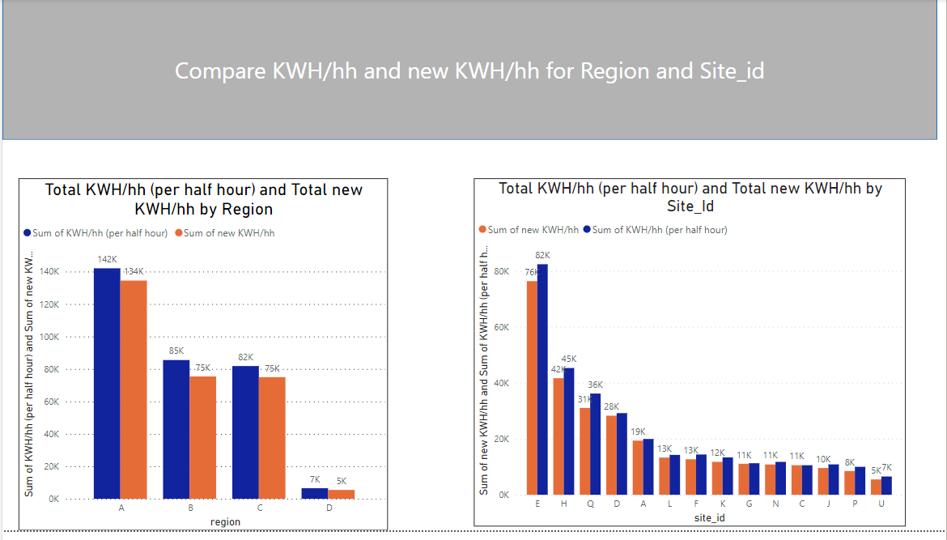
Power BI

Slide 80
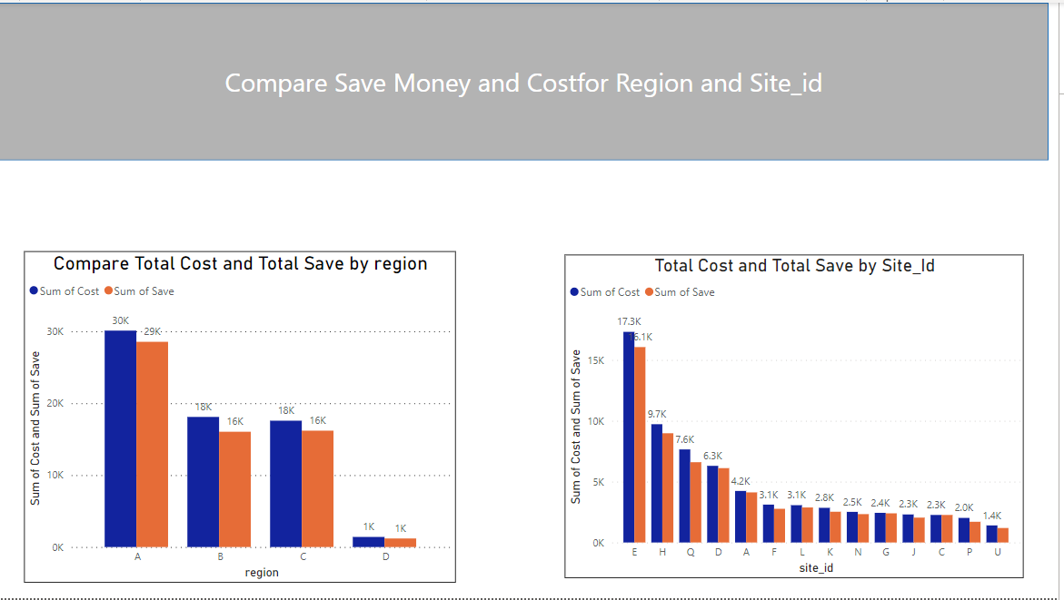
Power BI

Slide 81

Power BI

Slide 82

Power BI

Slide 83

Power BI

Slide 84
Thank you

